Slide 1
Comparing Anomaly-Detection Algorithms for Keystroke Dynamics
Project 4
STAT601
Fall 2021
South Dakota State University
Prepared By-
Tahmid Alam (101008957)

Slide 2
Outline
Background
Data
Objective
Algorithm
Exploratory Data Analysis
Developing Statistical Models
Conclusion
References

Slide 3
Background
Keystroke dynamics means the analysis of typing rhythms to discriminate among users.
Dr. Roy Maxian and colleagues recruited 51 subjects at CMU who have typed a passcode for a specific system.
Subjects completed 8 data-collection sessions (of 50 passwords each), for a total of 400 password-typing samples. They waited at least one day between sessions, to capture some of the day-to-day variation of each subject’s typing.
In this research they collected a keystroke dynamics data set, developed an evaluation procedure, and measured the performance of a range of anomaly-detection algorithms so that the results can be compared on an equal basis.

Slide 4
Objective
Our objective is to evaluate whether a user is consistent over time in how they type a given passcode.
Also, we compare total time for password input between random users to observe if there is any significance difference.
We develop a formal and appropriate statistical analysis of the data set.

Slide 5
Data
We have been provided with the typing data from 51 subjects, each typing 400 repetitions of a password in 8 sessions.
There are 31 various timing features used by researchers were extracted from the raw data.
We can classify the variable into 3 classes, the keydown-keydown times and hold times, keydown-keyup times.
During Analysis, we will be refereeing these variables types as-
Keydown-Keydown Time -> DD.Time
Keydown-Keyup Time -> UD.Time
Keyhold Times -> Hold.Time
We summed up the timing variables for each repetition during password input, this variable will be referred as , Total Time -> TT.Time

Slide 6
Algorithm
Exploratory analysis
Developing Statistical Model
Model Analysis
We performed different EDA analysis i.e., Total Time vs Repetition, Total Time vs Session Number to examine the trend of consistency over time for a user.
We also plotted boxplot, histograms, density plots to find out if there is significant difference among randomly selected different subjects’ password input times.
We developed a linear regression model based on individual subject's total time needed for every session to predict the total time needed for future sessions.
To examine the model's accuracy, we split the dataset into an 80:20 sample (training:test), then, build the model on the 80% sample and then used the model thus built to predict the dependent variable on test data.
To study the appropriateness of the model, we plotted diagnostics plots for the linear regression

Slide 7
Exploratory Data Analysis
In next slides we will be observing the whether a user is consistent over time in how they type a given passcode by analyzing total time for per repetition and per session.
Also, we will be applying data visualization such as BoxPlots, Histograms, Density Plots to find out if there is any difference between session total times of subject 57
Then to compare the mean of two sessions, we will be doing a unpaired two-samples t-test .

Slide 8
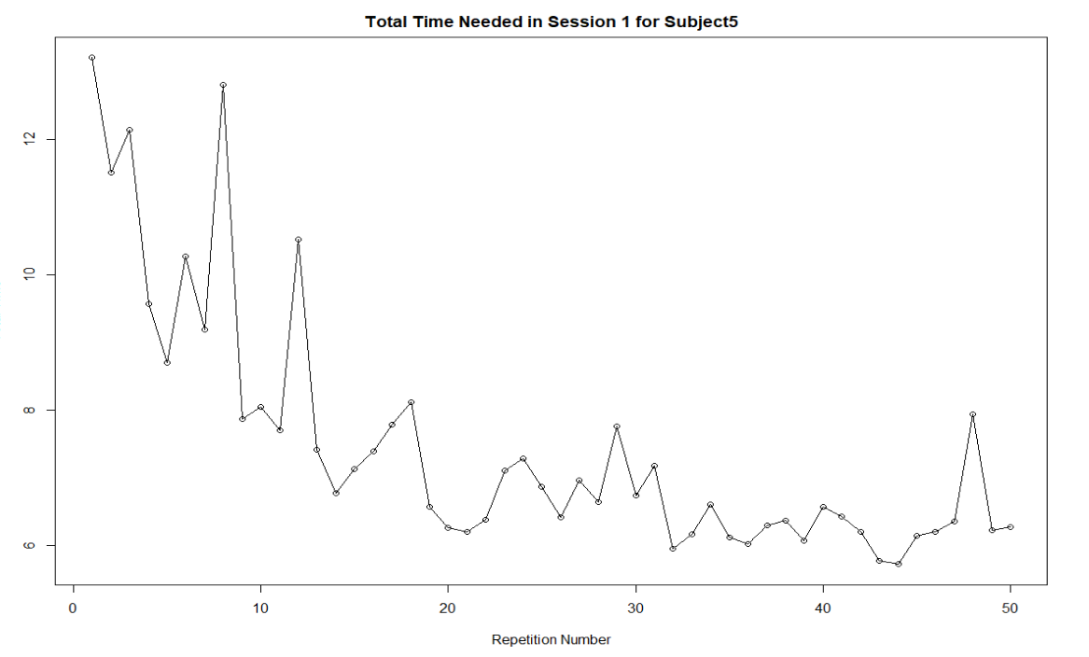
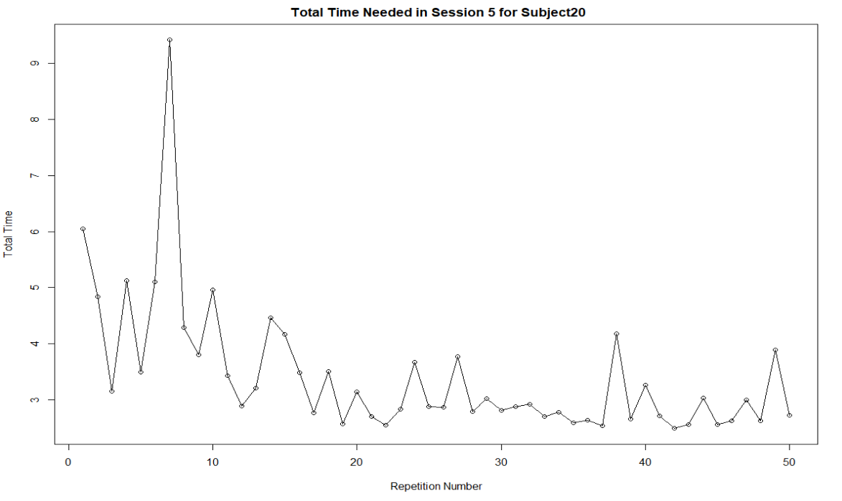
Exploratory Data Analysis
Here, We plotted Total Time vs Repetition Number for a single session for two random subjects.
From the plots, we can see that the trend of the Total Time vs Repetition Number is decreasing.
This means, with each repetition, the user get used to keystrokes of the password, hence reducing the total time.

Slide 9
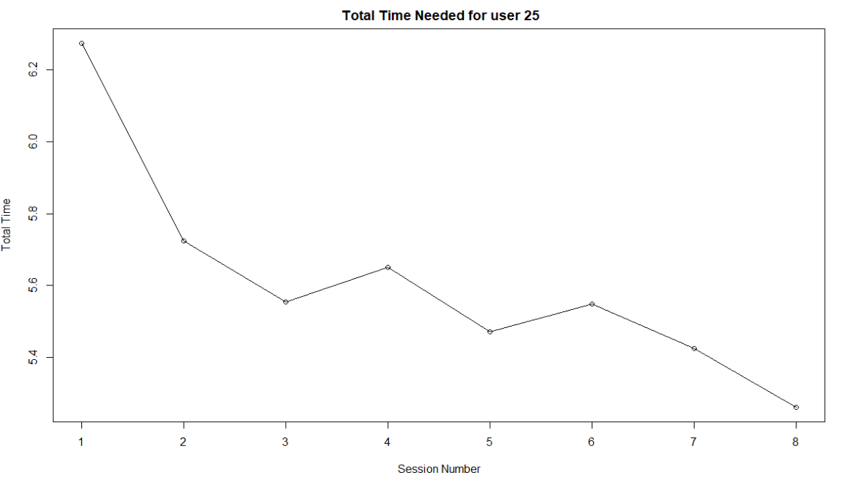
Exploratory Data Analysis
Here, We plotted Total Time vs Session Number for subject 25.
From the plots, we can see that the trend of the Total Time vs Repetition Number is decreasing,
This means, with each session, the user get used to keystrokes of the password, hence reducing the total time.

Slide 10
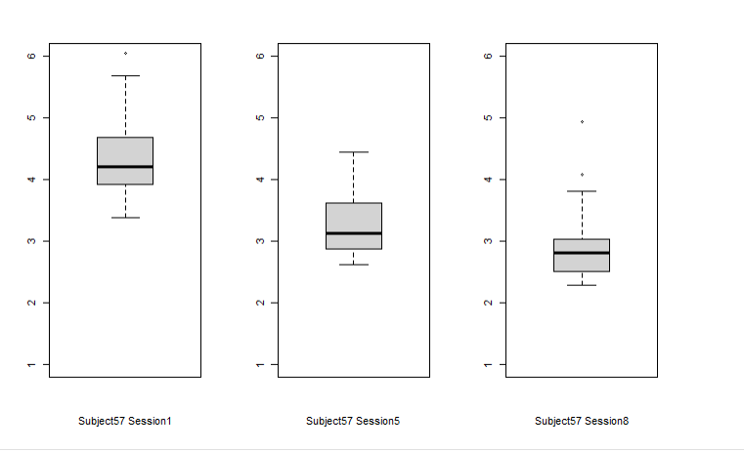
Exploratory Data Analysis
Here we compared Mean Total Time for three sessions for subject57
Box plots visualizes differences among groups.
The boxes represent the middle half of the values in each group.
From our boxplot, we can see that the boxes of the boxplots does not overlap with each other. So, there is difference between the three sessions.
Figure: Boxplot comparison among session number of Subject57

Slide 11
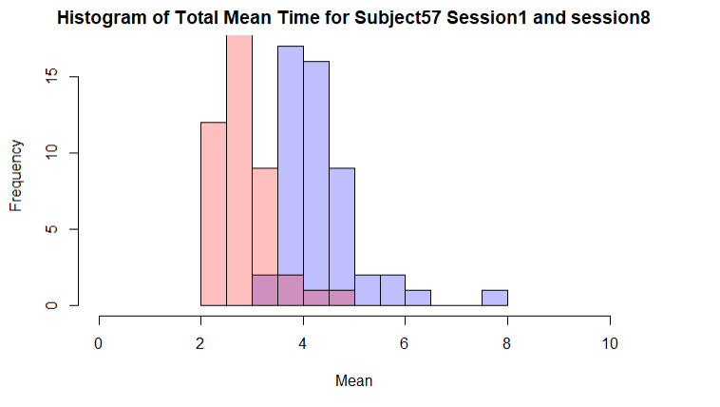
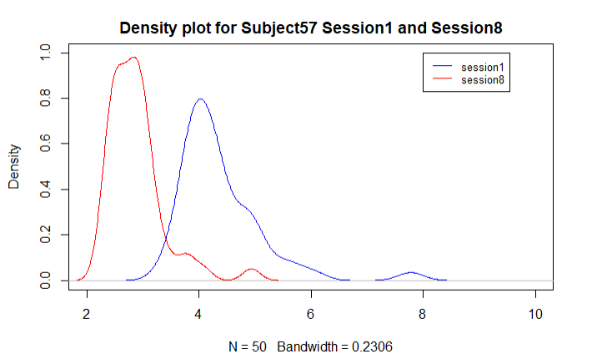
Exploratory Data Analysis
From the imposed histogram of total mean time for session1 and session8 we can see that there is little overlapping indicating difference between both groups.
From the density plot, we can see that the average total time for Session1 and session8 does not totally overlap indicating the difference between the groups. Also, we can observe a peak shift from session 1 to session 8 which means significant difference.

Slide 12
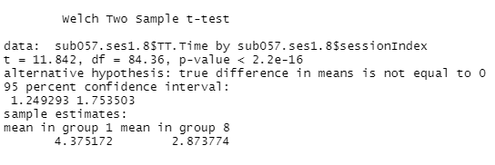
Exploratory Data Analysis
We performed two tailed t.test to compare between two session mean total time.
From the t test, The p-value of the test is 2.2e-16, which is less than the significance level alpha = 0.05 hence that the average total time for session1 and session8 of subject57 is significantly different from each other with a p-value = 2.2e-16.

Slide 13
Exploratory Data Analysis
In next slides we will be observing the total time average session wise of different random subjects and how are they related to each other..
Also, we will be applying data visualization such as BoxPlots, Histograms, Density Plots to find out if there is any difference between the groups
Then to compare the mean of two sessions, we will be doing a unpaired two-samples t-test .

Slide 14
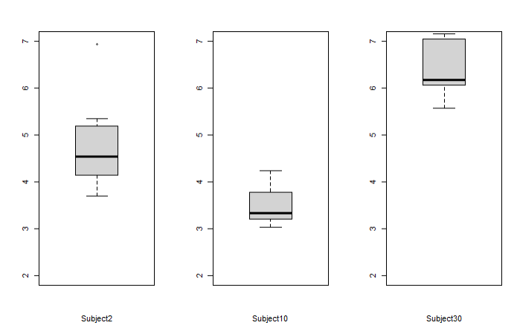
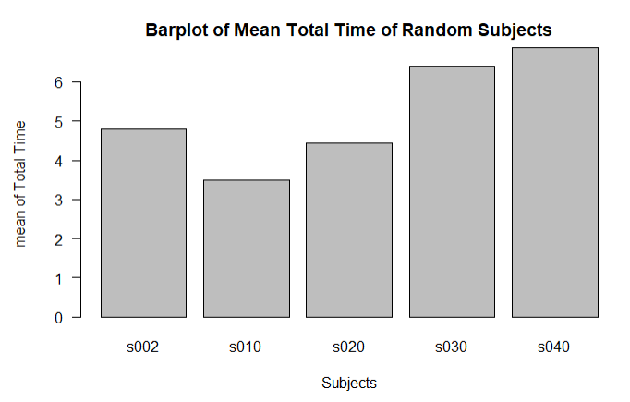
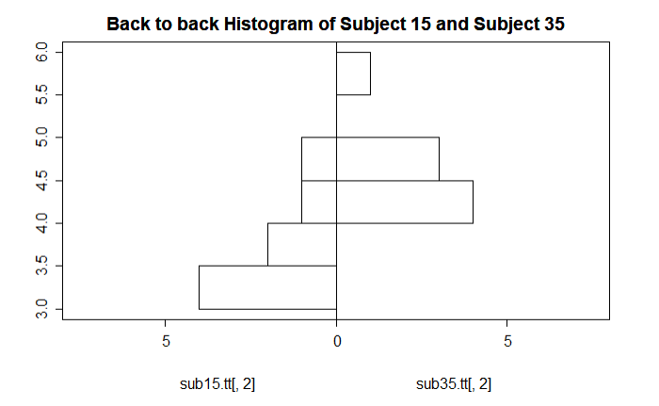
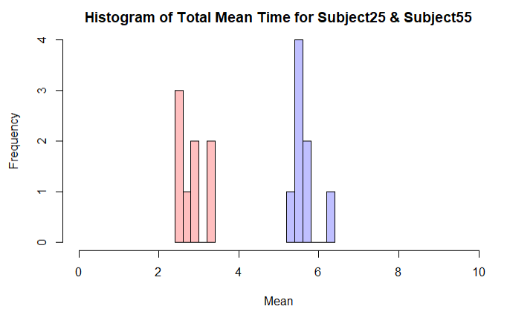
Exploratory Data Analysis
From the barplot, we can observe difference in the total mean time for various users.
From the boxplot, we can see that the boxes of the boxplots does not overlap with each other. So, there is difference between the three groups.
From the backtoback histogram plot above, Comparisons within the total mean time are made on a “common scale.” It clearly indicates difference between the total time for the users
From the imposed histogram of total mean time for subject 25 and subject55 we can see that there is no overlapping indicating difference between both groups.

Slide 15
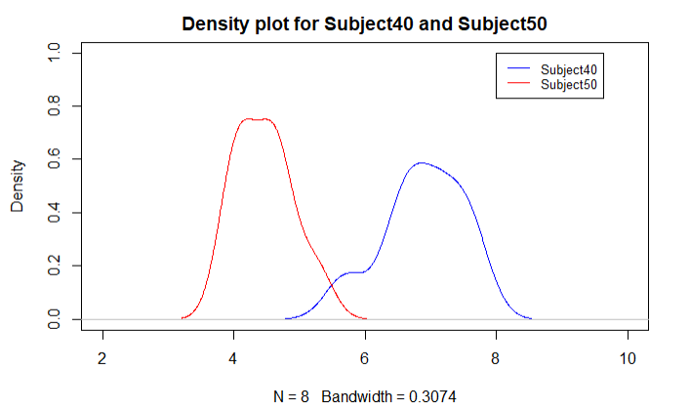
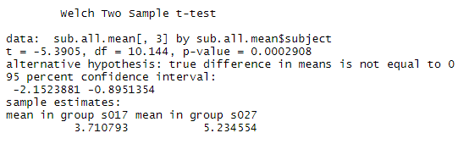
Exploratory Data Analysis
From the density plot, we can see that the average total time for Subject40 and Subject50 does not totally overlap indicating the difference between the groups.
From the t test, The p-value of the test is 0.0002908, which is less than the significance level alpha = 0.05. We can conclude that the average total time for subject17 is significantly different from the average total time for subject27 with a p-value = 0.0002908

Slide 16
Exploratory Data Analysis
In previous slides we observed the total time average session wise of different random subjects and how are they related to each other.
In next slides we will be observing the total DD.time, UD.Time and Hold.Time of different random subjects and how are they related to each other.
Also, we will be applying data visualization Pairsplot to find the correlation among the variables.
Then to compare the mean of two subjects, we will be doing a unpaired two-samples t-test based on each pair of variables.

Slide 17
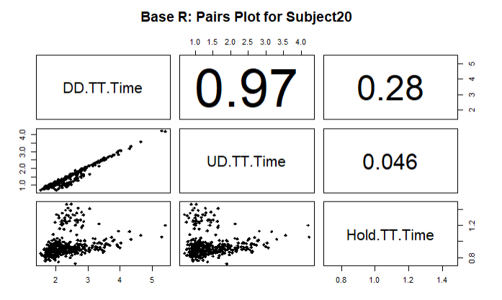
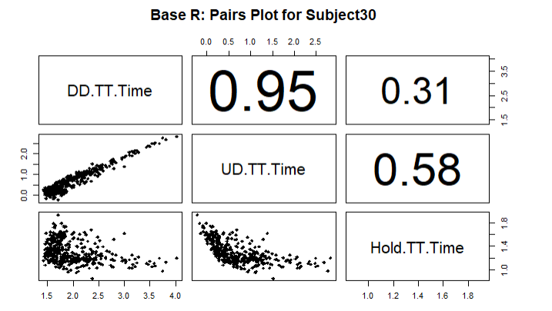
Exploratory Data Analysis
- From the correlation matrix, we can say that DD time and UD time for subject 20 positively correlated with a value of 0.97,
DD time and Hold time is weekly correlated with a value of 0.28.
UD time and Hold time is very weekly correlated with a value of 0.046.
From the correlation matrix, we can say that DD time and UD time for subject 30 positively correlated with a value of 0.97.
DD time and Hold time is weekly correlated with a value of 0.28.
UD time and Hold time is medium correlated with a value of 0.58.

Slide 18
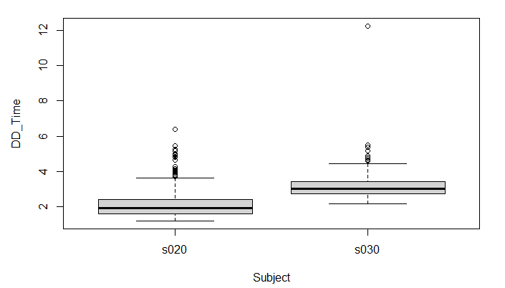
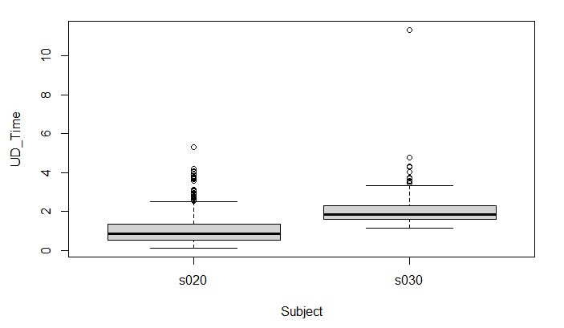
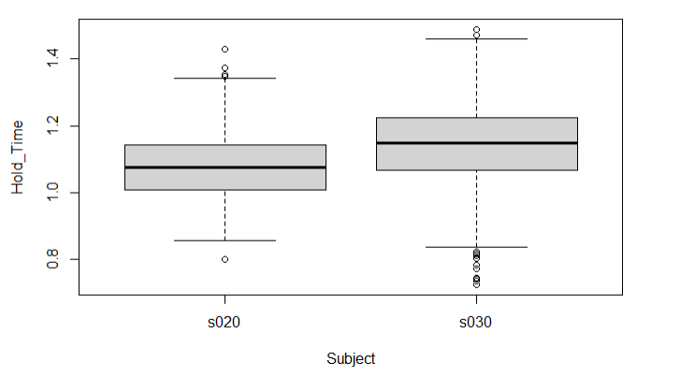
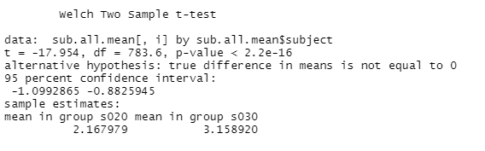
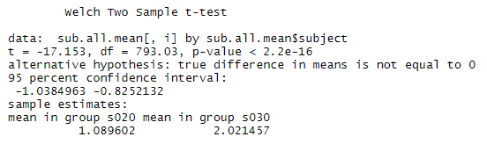
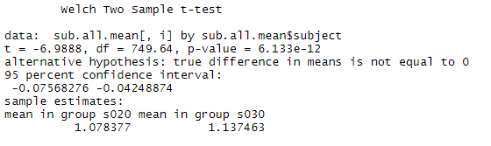
Exploratory Data Analysis
From the box plots, we can see the boxes for the variables is not overlapping which indicates the difference between them.
From the t-test, we can see that for each variable pairs, the p-values is smaller than the significance value of 0.05. So we can the variables DD time, UD Time and Hold time is significantly different from each other for both subjects.

Slide 19
Developing Statistical Model
Linear regression is used to predict the value of an outcome variable Y based on one or more input predictor variables X. The aim is to establish a linear relationship (a mathematical formula) between the predictor variable(s) and the response variable, so that, we can use this formula to estimate the value of the response Y, when only the predictors (Xs) values are known.
Here, we Developed a linear regression model for subject5. We took the average total time for password input for per session and the sessionIndex as the response variable.

Slide 20
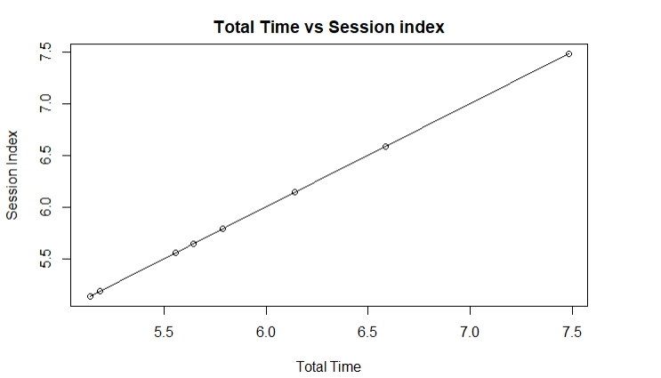
Developing Statistical Model
Before linear regression, we need to check scatterplot between the variables.
Scatter plots can help visualize any linear relationships between the dependent (response) variable and independent (predictor) variables.
The scatter plot along with the smoothing line above suggests a linearly decreasing relationship between the ‘Total Time’ and ‘Session’ variables.
This is a good thing, because one of the underlying assumptions in linear regression is that the relationship between the response and predictor variables is linear and additive.

Slide 21
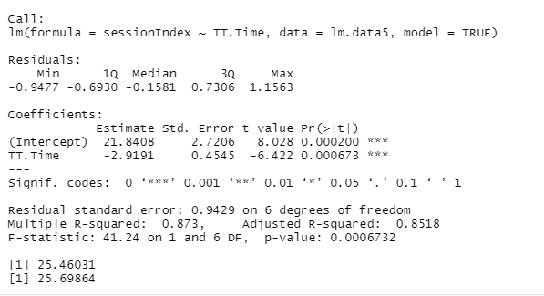
Linear Regression Model
 | Summary of Linear Regression
STATISTIC | Value | CRITERION
R-Squared | 0.87 | Higher the better (> 0.70)
Adj R-Squared | 0.85 | Higher the better
F-Statistic | 41.24 | Higher the better
Std. Error | 0.9424 | Closer to zero the better
t-statistic | -6.422 | Should be greater 1.96 for p-value to be less than 0.05
AIC | 25.46 | Lower the better
BIC | 25.69 | Lower the better
Here, the p-value is 0.000673 for TT.Time, We can consider a linear model to be statistically significant only when both these p-Values are less that the pre-determined statistical significance level, which is ideally 0.05.
R-Squared with 0.8518 tells us is the proportion of variation in the dependent (response) variable that has been explained by this model
F-statistic are measures of goodness of fit. with a F-statistics of 41.24, we can say its a fairly good model.
AIC and BIC is reletively low value which is a indication of good model.

Slide 22
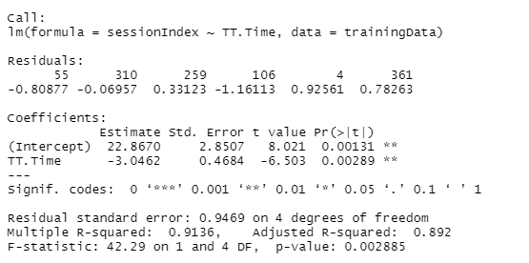

Accuracy Measurement of LM
STATISTIC | Value | CRITERION
MAPE | 8.114901 | Lower the better
Min_Max Accuracy | 92.09895 | Higher the better
To examine the model's accuracy, we split the dataset into a 80:20 sample (training:test), then, build the model on the 80% sample and then use the model thus built to predict the dependent variable on test data.
Doing it this way, we have the model predicted values for the 20% data (test) as well as the actuals (from the original dataset). By calculating accuracy measures (like min_max accuracy) and error rates (MAPE or MSE), we foundout the prediction accuracy of the model.

Slide 23
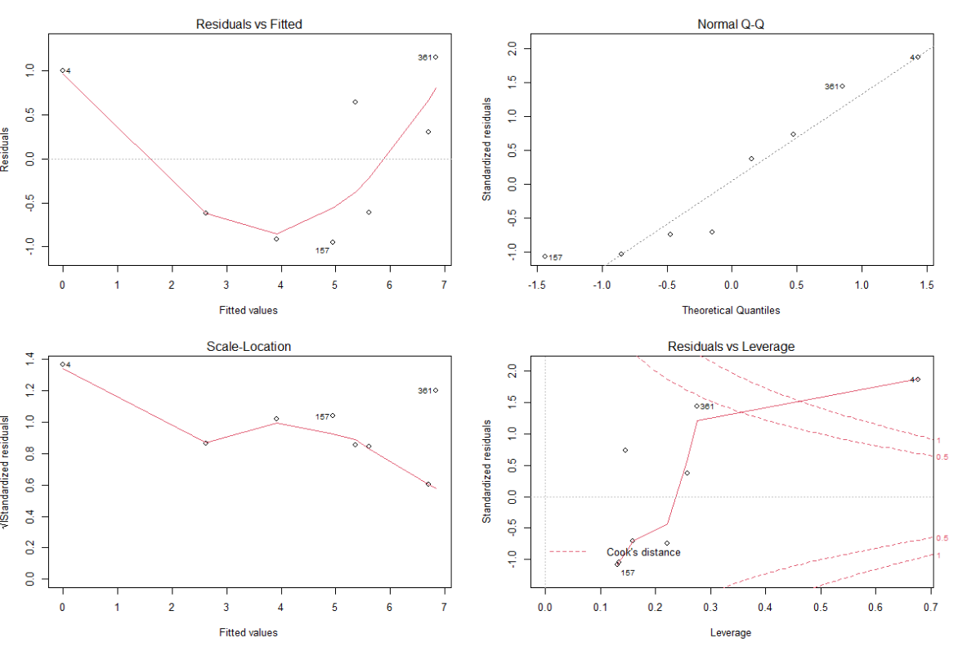
Diagnostics plot of LM
From the Residulas vs Fitted curve, we can see if residuals have non-linear patterns. There could be a non-linear relationship between predictor variables and an outcome variable and the pattern could show up in this plot if the model doesn’t capture the non-linear relationship. Here we can see equally spread residuals around a horizontal line without distinct patterns, that is a good indication we don’t have non-linear relationships.
The Q-Q plot shows if residuals are normally distributed. Here the residuals follow a straight line well.
Scale-Location plot shows if residuals are spread equally along the ranges of predictors. This is how we can check the assumption of equal variance (homoscedasticity). It’s good that we can see a horizontal line with equally (randomly) spread points.
Residuals vs Leverage plot helps us to find influential cases. a case is far beyond the Cook’s distance lines (the other residuals appear clustered on the left because the second plot is scaled to show larger area than the first plot). The plot identified the influential observation as #4.

Slide 24
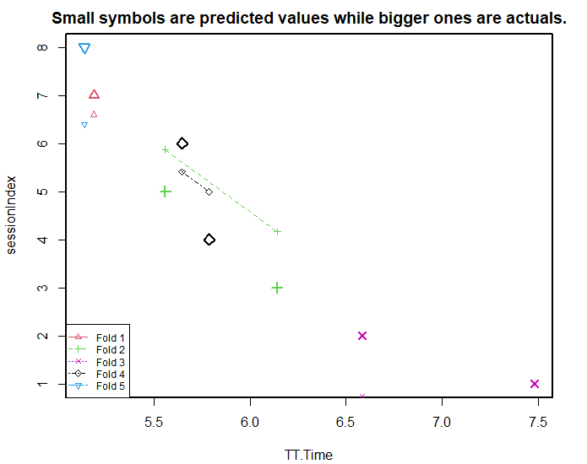
Accuracy Measurement of LM (k- Fold Cross validation)
k- Fold Cross validation is used to compare different linear models.
K- Fold Validation Steps-
Split the data into ‘k’ mutually exclusive random sample portions.
Keeping each portion as test data, the model on the remaining (k-1 portion) data and
Calculate the mean squared error of the predictions.
The average of these mean squared errors (for ‘k’ portions) is computed.
we need to see if the lines of best fit don’t vary too much with respect the the slope and level.
From our plot we can see the dashed lines are parallel. Also the small and big symbols are not over dispersed for one particular color.

Slide 25
Developing Statistical Model
Multiple regression is an extension of linear regression into relationship between more than two variables.
In simple linear relation we have one predictor and one response variable, but in multiple regression we have more than one predictor variable and one response variable.
Here we can develop a multiple linear regression with total time as a response variable with DD time, UD Time and Hold time as predictor variables. We create a subset of these variables from the data set for this purpose.

Slide 26
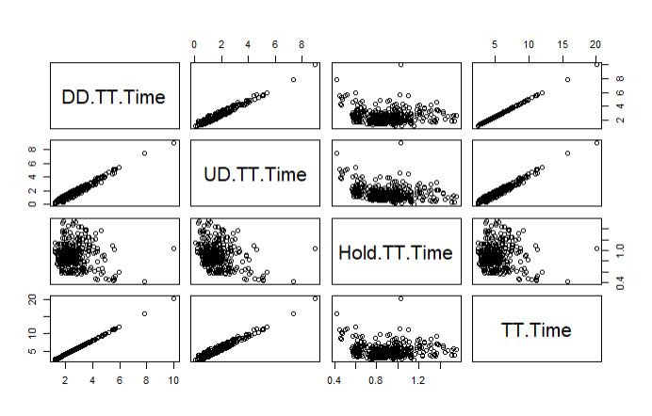
Developing Statistical Model
From the plot, we can see both DD time and UD time are highly correlated to TT.time. On the other hand , hold time shows weak correlation with TT.time.
Hence we can drop hold time from the regression model for improved result.is that the relationship between the response and predictor variables is linear and additive.

Slide 27
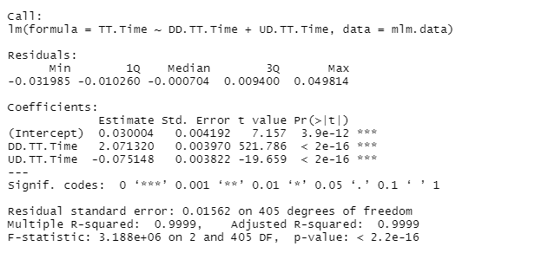
Linear Regression Model
Here, it can be seen that p-value of the F-statistic is < 2.2e-16, which is highly significant. This means that, at least, one of the predictor variables is significantly related to the outcome variable.
In our model, with DD time and UD time as predictor variables, the adjusted R2 = 0.99, meaning that “99% of the variance in the measure of TT.time can be predicted by DD time and UD time.

Slide 28
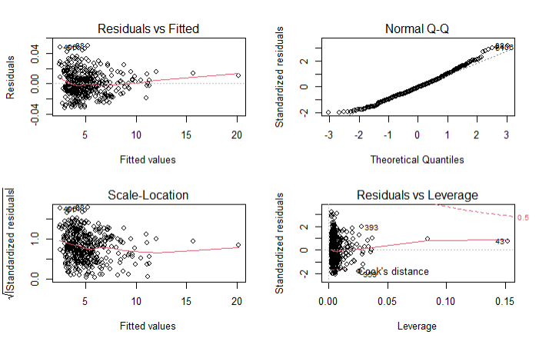
Diagnostics plot of MLM
From the Residulas vs Fitted curve, we can see if residuals have non-linear patterns. There could be a non-linear relationship between predictor variables and an outcome variable and the pattern could show up in this plot if the model doesn’t capture the non-linear relationship. Here we can see equally spread residuals around a horizontal line without distinct patterns, that is a good indication we don’t have non-linear relationships.
The Q-Q plot shows if residuals are normally distributed. Here the residuals follow a straight line well.
Scale-Location plot shows if residuals are spread equally along the ranges of predictors. This is how we can check the assumption of equal variance (homoscedasticity). It’s good that we can see a horizontal line with equally (randomly) spread points.
Residuals vs Leverage plot helps us to find influential cases. we can barely see Cook’s distance lines (a red dashed line) because all cases are well inside of the Cook’s distance lines.

Slide 29
Conclusion
From our statistical Analysis, we can see that total time for one subject to put in the keystroke of designated password gradually changes with repetition and session. We have demonstrated the difference with graphical analysis such as plots, boxplot, histogram, density plots. Also, we performed a two tailed t.test to determine if there is a significant difference between the means of two groups.
Later, we demonstrated that there are total time differences for every subjects as the vary in mean total time.
Lastly, we developed a Linear Regression Model to predict the value of a dependent variable which is Total Time based on an independent variable. The greater the linear relationship between the independent variable and the dependent variable, the more accurate is the prediction.
We Also developed a multiple linear regression with total time as a response variable with DD time, UD Time and Hold time as predictor variables.

Slide 30
References
https://www.cs.cmu.edu/~keystroke/KillourhyMaxion09.pdf
https://www.cs.cmu.edu/~keystroke/
https://github.com/RoyMaxion/RoyMaxion.github.io/blob/master/projects/keystroke-benchmark/evaluation-script.R
http://r-statistics.co/Linear-Regression.html
http://www.sthda.com/english/articles/40-regression-analysis/168-multiple-linear-regression-in-r/
https://stackoverflow.com/questions/65124061/confusion-matrix-for-a-logistic-model
https://github.com/cran/sparklyr/blob/c0effdbed11c95e42ea37193b1cfe2516217516b/R/ml_classification_logistic_regression.R
https://towardsdatascience.com/understanding-boxplots-5e2df7bcbd51
https://www.statmethods.net/graphs/density.html
http://www.sthda.com/english/wiki/unpaired-two-samples-t-test-in-r
https://data.library.virginia.edu/diagnostic-plots/
https://statisticsbyjim.com/regression/choosing-regression-analysis/
https://www.investopedia.com/terms/m/mlr.asp
https://www.northeastern.edu/graduate/blog/statistical-modeling-for-data-analysis/

